Slide 1
How to Build a CI/CD Pipeline
Mohamed Radwan
DevOps Engineer

Slide 2

Overview
Introduction to Gitlab
Gitlab CI Configuration file
(CI/CD) Pipeline
Immutable AWS Deployments
Creating Image
Testing Image
Configuration Management Tools
Deploy Image
Demo

Slide 3



Introduction to Gitlab
A git-based code like github.
A (CI/CD) platform like Jenkins , Travis and others.
Gitlab components:
1- Gitlab server : hosting service, CI build system management
2- Gitlab runners: User-space that execute builds.
- Highly configurable you can have multiple runners per repo.
- It can run anywhere: laptop , AWS ..etc

Slide 4




Introduction to Gitlab

Slide 5
Gitlab CI configuration file
Standard YAML
– Very human-friendly
– .gitlab-ci.yml, in the top directory of your git repository
– Describes pipelines which consist of stages
– Each stage has a specific function: build, test, deploy…
– Each stage can have its own tags.
– Each stage can produce artifacts re-use from other stages
– Stages can run in parallel

Slide 6
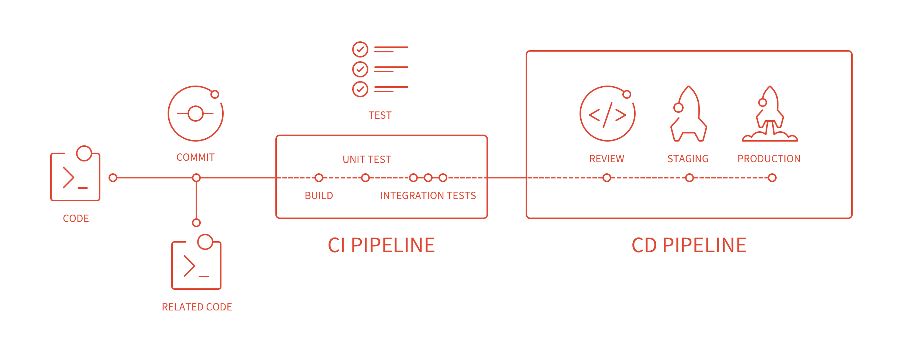
(CI/CD) Pipeline

Slide 7
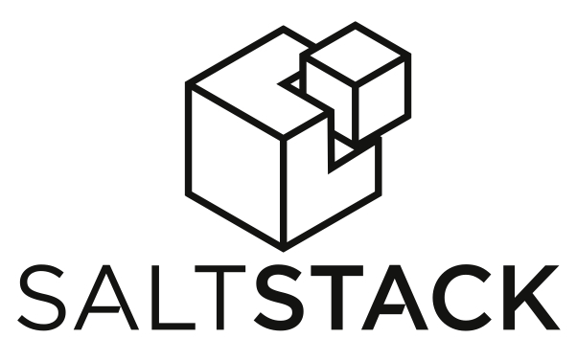
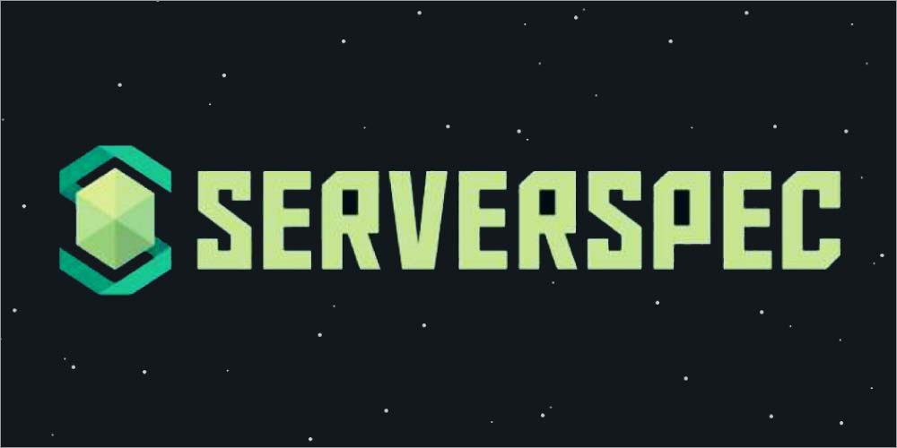



Immutable AWS Deployments
Automate the setup and deployment for every part and every layer of your infrastructure.
Never change any part of your system once it is deployed. If you need to change it, deploy a new system.

Slide 8
Creating Image
Packer is an open source tool for creating images for multiple platforms from a single source configuration.
Packer does not replace configuration management like Chef , Puppet, SaltStack and Ansible .
Packer is able to use tools like Chef or Puppet to install software onto the image.
Machine image formats examples: Ami for EC2, VMDK/VMX files for VMware, OVF exports for VirtualBox

Slide 9
Testing Image
Serverspec is the name of a Ruby tool which allows you to write simple tests, to validate that a server is correctly configured
With Serverspec, you can write RSpec tests for checking your servers are configured correctly.
Resource Types:
bond | bridge | cgroup | command | cron | default_gateway | docker_container | docker_image | file | group | host | interface | ip6tables | ipfilter | ipnat | iptables | kernel_module | linux_audit_system | linux_kernel_parameter | lxc | mail_alias | mysql_config | package | php_config | port | ppa | process | routing_table | selinux | selinux_module | service | user | x509_certificate | x509_private_key
describe package('nginx') do
it { should be_installed }
end
describe port(80) do
it { should be_listening }
end
describe cron do
it { should have_entry '* * * * * /usr/local/bin/foo' }
end

Slide 10
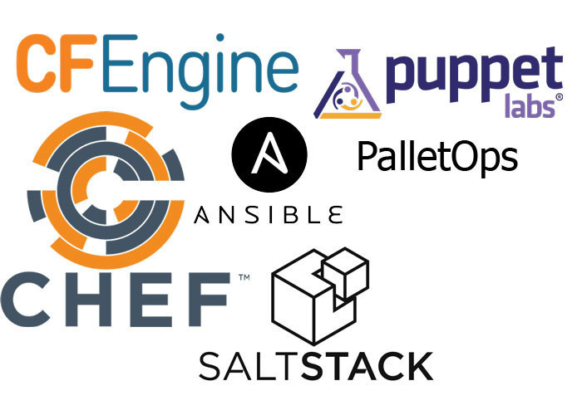
Configuration Management Tools
Puppet, Chef, Ansible and SaltStack present different paths to achieve a common goal of managing large-scale server infrastructure .
Configuration Management capabilities offers the following :
- Orchestration
- Automated provisioning
- Configuration automation
- Code management
- Reporting

Slide 11
Deploy Image
Terraform is a tool for building, changing, and versioning infrastructure safely and efficiently.
Infrastructure as Code : can be shared and re-used.
Change Automation : Complex changesets can be applied to your infrastructure with minimal human interaction.

Slide 12
DEMO
Build AMI using Packer and SaltStack
Testing AMI by Using serverspec and packer
Deploy by using Terraform.

Slide 13
Q & A

